Slide 1
EUR/USD Time Series Analysis Spencer Buckner

Slide 2
Why?
Gain better understanding of the EUR/USD currency
Explore relationships between technical and fundamental data
Goal is to predict next day close pricing of EUR/USD
The more accurate our prediction, the better we can predict future price movements

Slide 3
Data Gathering
2 Schools of thought on data input
Technical Data
Kaggle Dataset
Wall Street Journal
Fundamental Data
Treasury.gov
Forexfactory.com

Slide 4
Data Cleaning
Due to the nature of financial data being relatively complete, there were very few null values
Technical Data was resampled for business days only to line up with fundamental data
Yield curve data regarding 2 mo and 30 yr were dropped due to high null values present
Economic data (non treasury rates) were set to binary (1,0) and if they beat their expected forecast, it was marked 1.

Slide 5
Technical & Fundamental Data Features
Technical Data
Fundamental Data
Bid Open
Bid High
Bid Low
Bid Close
Daily Treasury Rates (1 mo, 3 mo, 6 mo, 1 yr, 2 yr, 3 yr, 5 yr, 7 yr, 10 yr, 20 yr)
Federal Funds Rate - Interest rate at which depository institutions lend balances held at the Federal Reserve to other depository institutions overnight
Main Refinancing Rate - Interest rate on the main refinancing operations that provide the bulk of liquidity to the banking system in Europe

Slide 6
Fundamental Data contd.
Retail Sales - Change in the total value of sales at the retail level
Core Retail Sales - Change in the total value of sales at the retail level, excluding automobiles
PPI m/m - Change in the price of finished goods and services sold by producers
Unemployment Rate - Percentage of the total work force that is unemployed and actively seeking employment during the previous month
CPI m/m - Change in the price of goods and services purchased by consumers
Core CPI m/m - Change in the price of goods and services purchased by consumers, excluding food and energy
Prelim GDP q/q - Annualized change in the value of all goods and services produced by the economy

Slide 7
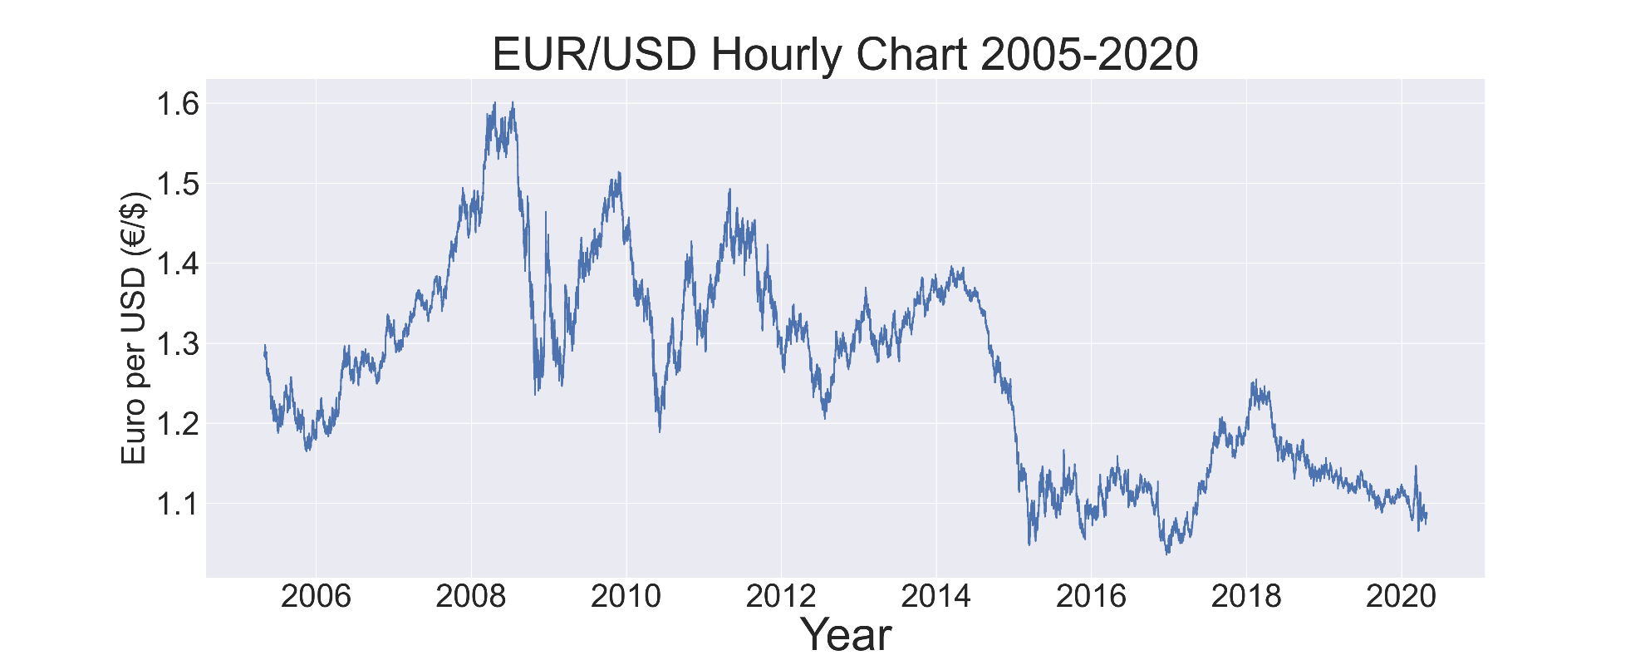
Data Exploration

Slide 8
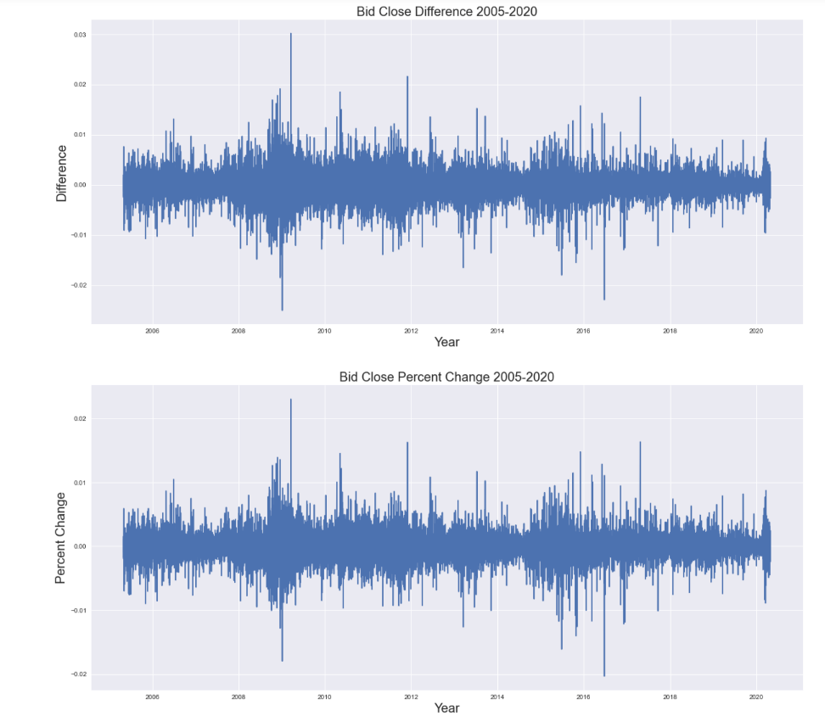
Bid Close Diff and Percent Change 2005-2020

Slide 9
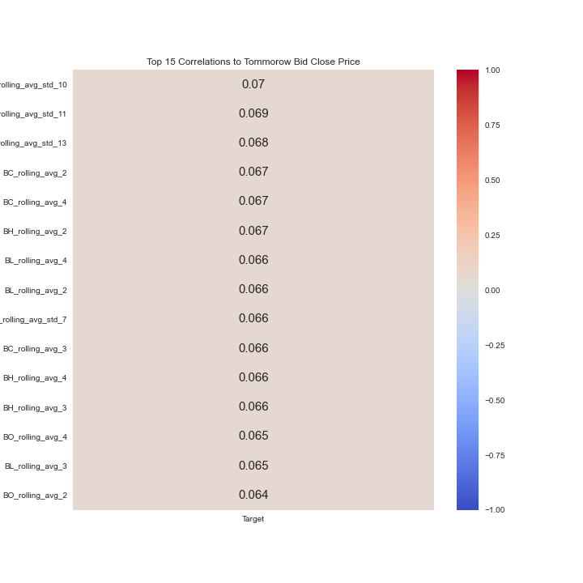
Rolling Average/STD Correlation

Slide 10
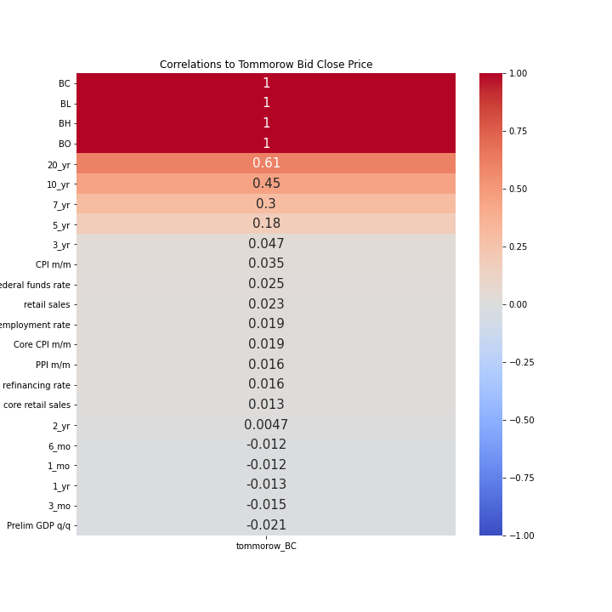
Feature to Target Correlation

Slide 11
Modeling
LSTM Model (Long Short-Term Model)
Recurrent Neural Network Model
Uses a progression of gates each with its own RNN that will keep, forget, or ignore data points based on a probability model
Helps solve problems simple RNN’s face with gradient descent since RNN can keep, forget, or ignore values
Mean Absolute Percentage Error (MAPE) – metric used that tracks how far off the model prediction was from the actual value and returns the total mean value on all points

Slide 12
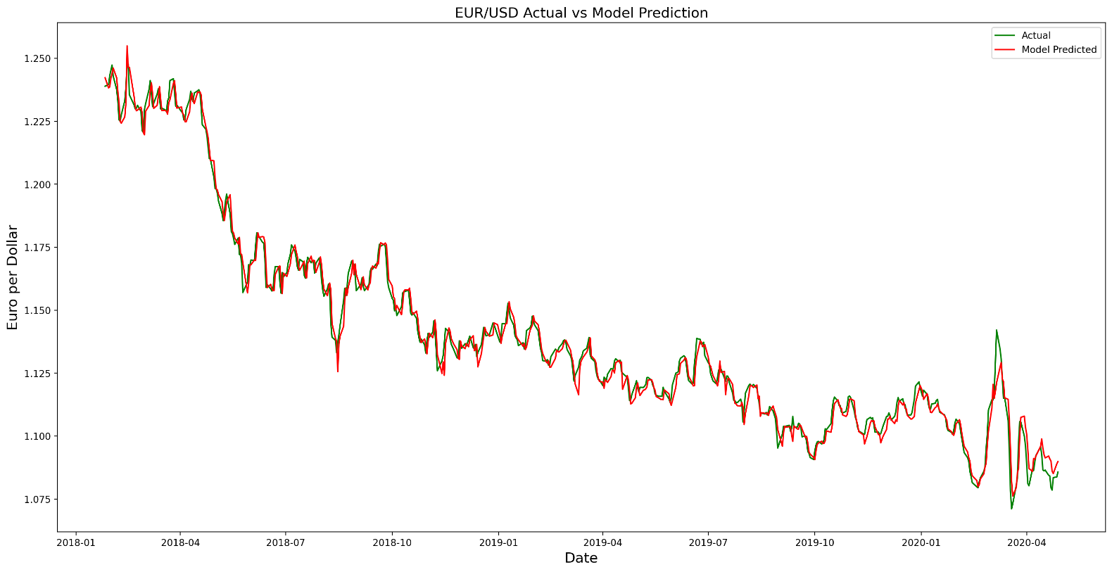
Model Prediction vs Actual on Test Data
R2 Score = 0.99

Slide 13
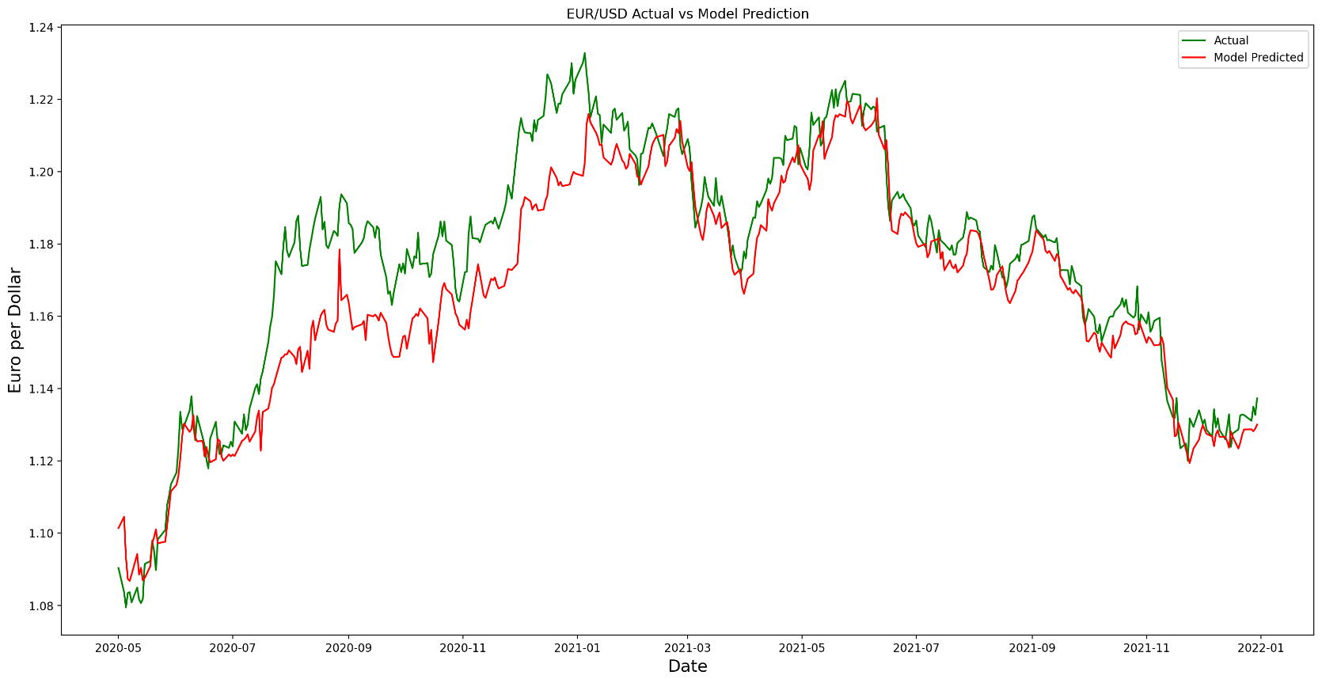
Model Prediction vs Actual on Future Data
R2 Score = 0.83

Slide 14
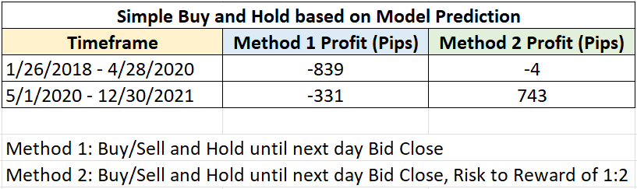
Simple Trading Strategies
Model 1: Average prediction versus actual difference ~30 pips
Actual Data: average daily movement is 45 pips

Slide 15
Conclusion
Yield curve rates for higher time frame periods all produced higher correlations than their respective short term counter parts. As further models are created, this will be an interesting feature to expand upon. Other economic indicators represented as binary inputs did not seem to add anything to predicting next day bid close.
As trends continued, the model was able to stay within a relative range in the same direction as the next day bid close. Due to the model not being able to predict inflection points well, the strategy employed above of buy/sell and holding had several days of losses around these points, but still was able to produce a profit when implementing a risk to reward ratio.

